Slide 1

Project : Analyses of Customer Service Data
Name – Shishir kherod
Batch – ABADS-B11
E-mail id – kherodshishir@gmail.com
Contact No. - +91 8527473607

Slide 2
PROJECT
iVision is a well-known analytics firm. iVision does analytics on the data shared by their clients. Recently, iVision collaborated with Nile, an E-commerce company. Nile intends to improve their customer service, but before doing so, Nile wants to get some insights on their customer service request data. To help Nile make better business decisions and improve their services, iVision is engaged to provide Nile access to the analytics dashboard and report.
Nile has shared its customer service data with iVision. As an employee of iVision, you are responsible for creating this analytics report.

Slide 3
What Analytics Framework should be taken into account for the completion of given Task or Project?
The choice of analytics framework for a task or project depends on the specific objectives, complexity, and nature of the
project. Here we’ll be using CRISP-DM for this Project.
CRISP-DM stands for Cross-Industry Standard Process for Data Mining. It's a widely used methodology in the field of data
mining and analytics. The approach is a structured and comprehensive way to guide professionals through the stages of a data
mining project, from understanding the business problem to deploying the results. The CRISP-DM process consists of six main
phases.
CRISP-DM is iterative, meaning it’s common for the process to cycle back to previous stages as new insights are gained or as
requirements change. The flexibility of this methodology allows data scientists and analysts to adapt and refine their approach
based on the ongoing analysis and evolving business needs.

Slide 4
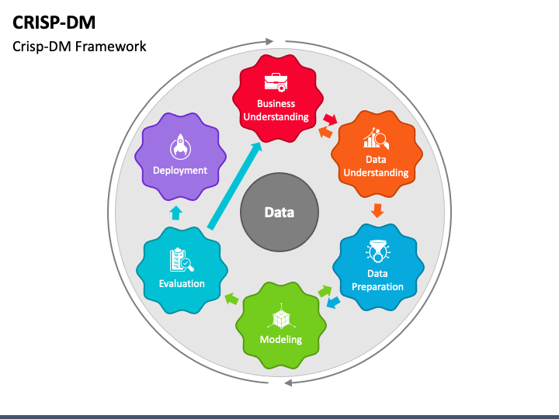
CRISP-DM Chart Structure
Business Understanding:
Goals and objectives
Project plan
Business success criteria
Data Understanding:
Data collection sources
Data exploration
Initial data description
Data Preparation:
Data cleaning
Data transformation
Data pre-processing
Modeling:
Selection of modeling techniques
Building models
Assessing model quality
Evaluation:
Model assessment
Business success criteria evaluation
Review of process
Deployment:
Deployment plan
Final report
Project review

Slide 5
Business Understanding: This initial phase involves understanding the project objectives, requirements, and determining how data mining can provide solutions to the business problem.
Business Objective:
The analysis aims to leverage data-driven approaches to optimize customer service processes, enhance customer experience, and drive overall business growth. By examining historical customer service data, the project seeks to identify patterns, trends, and opportunities for improvement, ultimately leading to enhanced customer loyalty and increased operational efficiency.
Project Goals:
• Customer Sentiment Analysis: Perform sentiment analysis on customer interactions. Identify positive, negative, and neutral sentiments expressed by customers to understand overall satisfaction levels.
• Root Cause Analysis: Investigate common customer complaints. Pinpoint recurring problems to address them proactively and prevent future escalations.
• Service Response Time Analysis: Analyse response times for customer queries and support requests to assess the efficiency of the customer service team.
• Customer Segmentation: Segment customers based on their demographics, behaviour, and preferences. Understand different customer segments' needs and pain points to tailor services and communications accordingly.
• Trends and Patterns Identification: Identify patterns and trends in customer service data to uncover opportunities for process improvements and innovative service offerings.

Slide 6
2. Data Understanding: In this phase, data collection, exploration, and initial data quality assessment take place. It involves understanding the available data sources, their quality, and their potential to meet the project objectives.
Here we have the original data file which will show what is the task which we have to perform and how we have to proceed with it.
3. Data Preparation: This phase involves cleaning, transforming, and pre-processing the data to make it suitable for analysis. Tasks include dealing with correction of file type, missing values, handling outliers, removing duplicates and transforming data into a usable format.
4. Modeling: In this phase, various modeling techniques are selected and applied to the prepared dataset. Different algorithms and
methodologies are used to build and assess models based on the business problem.
For this projects we have use different Pivot tables, charts and slicers according to the requirement and analysis.
We have in total of five goals that we have to achieve based on the given data :

Slide 7
Customer Sentiment Analysis : Here we have performed sentiment analysis on customer interactions through Pie chart and Identified positive, negative, and neutral sentiments expressed by customers to understand overall satisfaction levels.

Slide 8
B. Root Cause Analysis: We have investigated common customer complaints. Pinpoint recurring problems to address them proactively and prevent future escalations.

Slide 9
C. Service Response Time Analysis: Analyse response times for customer queries and support requests to assess the efficiency of the customer service team.

Slide 10
D. Customer Segmentation: Segment customers based on their demographics, behaviour, and preferences. Understand different customer segments' needs and pain points to tailor services and communications accordingly.
Channel | Count of ID
Call-Center | 10639
Negative | 3570
Neutral | 2785
Positive | 1245
Very Negative | 1983
Very Positive | 1056
Chatbot | 8256
Negative | 2737
Neutral | 2201
Positive | 983
Very Negative | 1526
Very Positive | 809
Email | 7470
Negative | 2565
Neutral | 1995
Positive | 863
Very Negative | 1344
Very Positive | 703
Web | 6576
Negative | 2191
Neutral | 1773
Positive | 837
Very Negative | 1173
Very Positive | 602
Grand Total | 32941

Slide 11
E. Trends and Patterns Identification: Identify patterns and trends in customer service data to uncover opportunities for process improvements and innovative service offerings.
By analysing the bar chart it is clear that most of the
communication is related to billing question through
all the four channel modes.
So the process of Billing should be reviewed and
checked for any improvement or rectification.
Whereas on payment only one channel has been
considered i.e. call centre which makes it limited and
busy for communicating. By improving mail and web
channel for queries and rapid solution, the traffic on
call-centre can be diverted over these other channels
which can result a decrease in call-centre traffic.
By the analysation from Bar chart we learn that the
Service outage queries are resolved over three
Channels but not on call-centre. As the queries over
this reason are minimum we can assume that it is
getting resolved over the respective channels.

Slide 12
5. Evaluation: Once models are created, they need to be evaluated to determine their effectiveness in addressing the
business objectives. This phase involves assessing model performance, considering different metrics, and selecting
the best model.
6. Deployment: In this final phase, the insights and knowledge derived from the data are deployed into the business.
This could involve implementing the model into a production environment, creating a report, or taking actions
based on the results.

Slide 13
THANKYOU

